Slide 1
Bad Design Journal

Slide 2
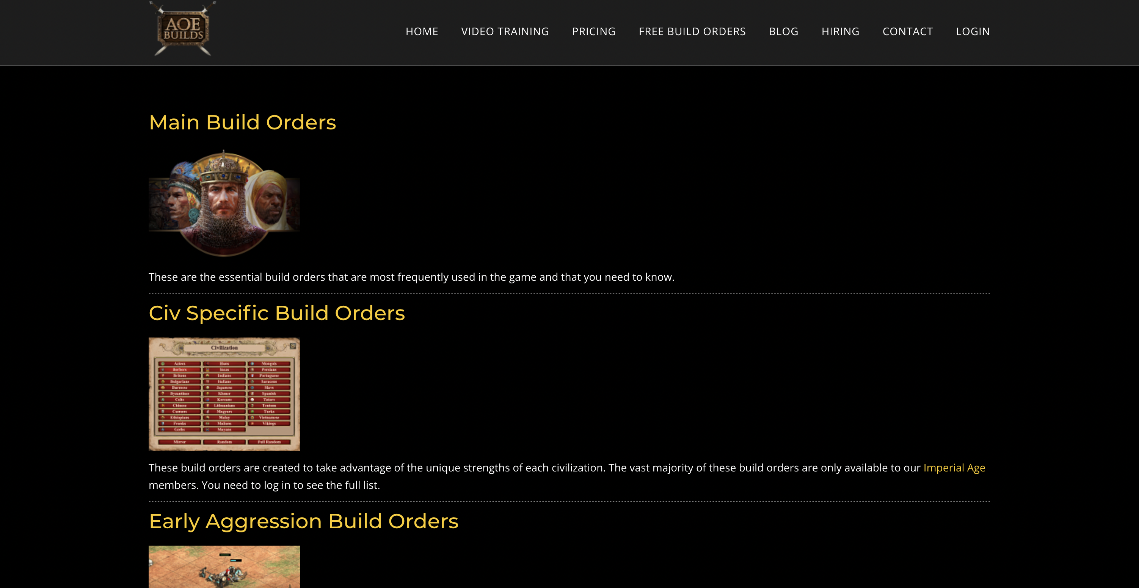

AOEBuilds.com

Slide 3
Consistency is key
Norman Principle: Consistency
Shneiderman Golden Rules: Strive for consistency
Nielsen’s 10 rules: Consistency and standards

Slide 4
Consistency Is key
Adopt One Theme
Online Training
Contrast of Cards

Slide 5
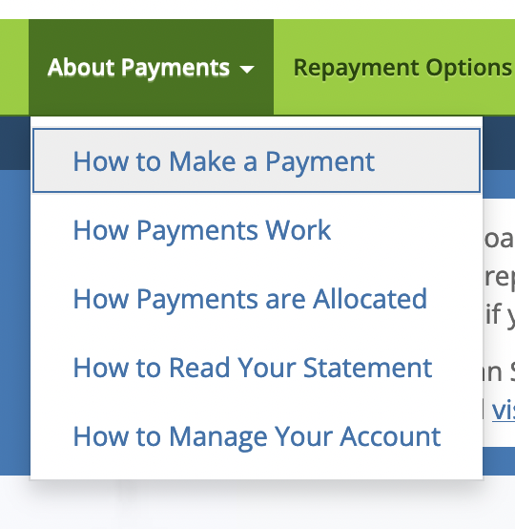

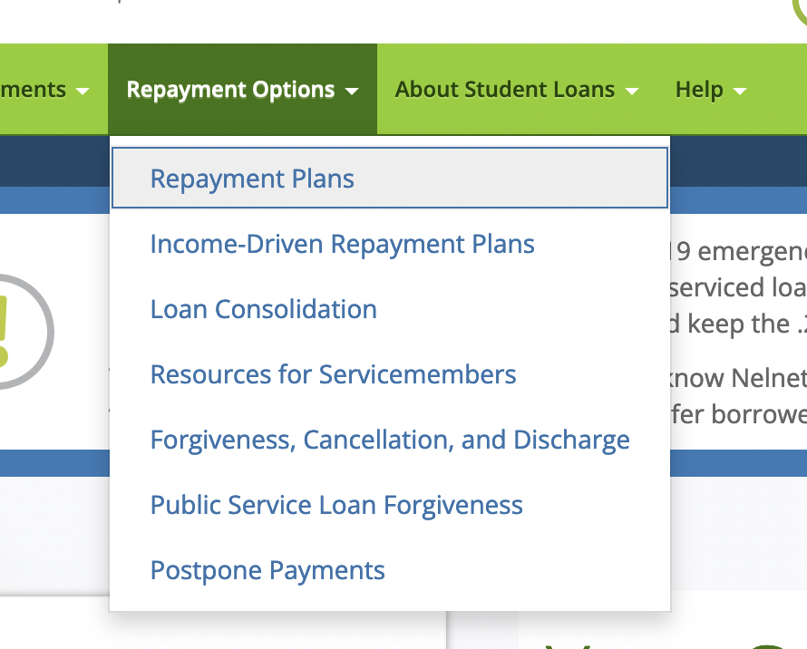

nelnet.com

Slide 6
Affordance and Attention
Norman’s Principles: Affordance
Nielsen’s 10 rules: Recognition rather than recall
Golden Rules: Reduce short-term memory load

Slide 7
Affordance and Attention
Regroup menu items
Use common categories (Account, Information, etc)
Try and reduce users need to remember which of the menu categories with similar names have the menu item they are looking for

Slide 8

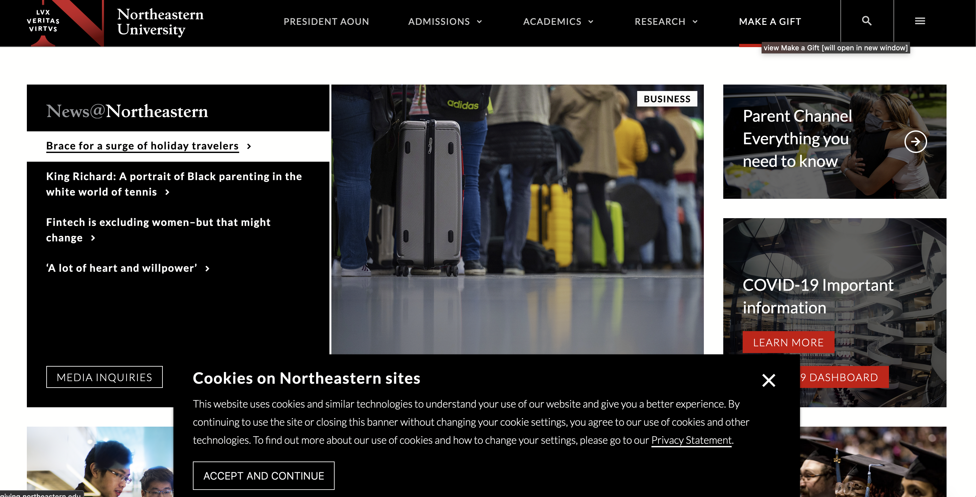
Northeastern.edu

Slide 9
Design issues
Golden Rule: Permit easy reversal of actions.
Nielsen's 10 Heuristics: User control and freedom

Slide 10
Ways to fix the issue
Create a way to navigate back the northeastern home page from the subpages
Don’t isolate users to subpages

